Slide 1


EmPhAsIS Empowering Pharmacists in Asthma management through Interactive SMS
Baseline Procedures:
Consenting and Enrolling Patients
emphasis.core.ubc.ca
Click for more information
Notes:
This mini-webinar will go over procedures for consenting and enrolling a new patient into the Emphasis study. It applies to both intervention and usual care groups and is the next step after you have identified a patient at your pharmacy who is eligible to be in the study.

Slide 2
EmPhAsIS Empowering Pharmacists in Asthma management through Interactive SMS
To review how to recruit and screen a potential study participant,
please see the previous mini-webinar on:
“Baseline Procedures: Recruiting and Screening Patients”
Once you have identified a study participant who is willing to participate in the study and fulfills in the inclusion criteria, you are now ready to start obtaining consent and officially enrolling the patient into the study!
Notes:
If you would like a refresher on how to recruit and screen a potential study participant then refer to the mini-webinar prior to this one, it is titled “baseline-procedues: recruiting and screening patients”
The current webinar applies to consenting and enrolling patients who have already fulfilled the inclusion criteria for the study. Now let’s begin.

Slide 3

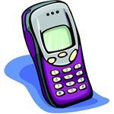
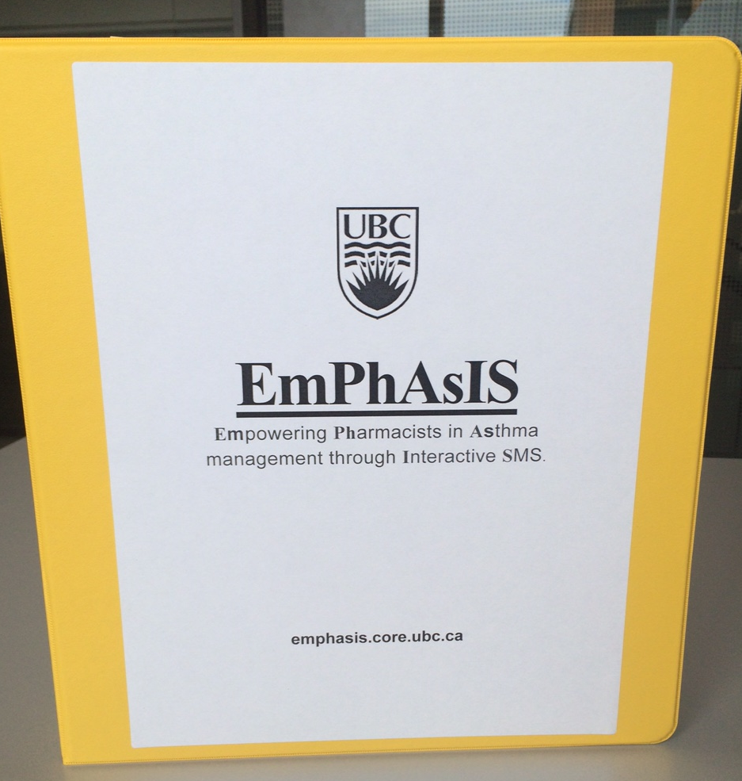
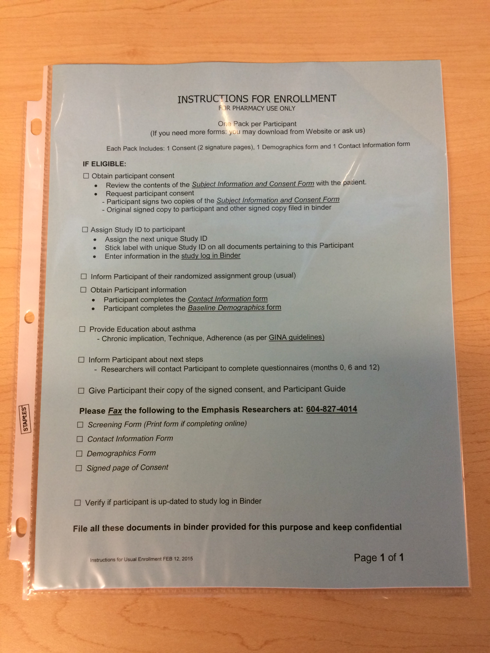
+
For Eligible Patients
In your binder
10 Enrolment Packages (in plastic covers)
Instructions
Subject Information and Consent Form
Contact Form
Demographic Form
Participant Guide
[Magnet – Intervention Group only]
Use 1 package per eligible patient
Notes:
Open your study binder and find the enrolment packages already prepared for you. There are a total of 10 packages in plastic sleeves. Each package contains everything you will need to enrol one patient. In the package you will find a blue sheet with instructions and a checklist on the procedures to enroling the patient. A white subject information and consent form. A green participant contact information form. A yellow demographic form, and a coloured participant guide. Intervention study groups will also receive a magnet that looks like a cell phone to remind patients about the text messages they will receive as part of the emphasis study.

Slide 4
1. Consent Eligible Patients
+
Important part of enrollment process
Review Subject Information and Consent Form with patient
Have patient sign the 2 copies of page 9
1 copy stapled to form → Patient takes home
1 copy not stapled → Fax to UBC and File in binder
AFTER the patient has signed the consent form, you may inform him/her of the study group assignment
Notes:
Once you have your eligible patient, it is important to go through the subject information and consent form with the patient. These forms contain all the information they will need to know about who is conducting the study, the purpose of the study, the benefits and potential risks to the patient, and the confidentiality of their personal information. Once the patient has had time to read over the form and agreed to enrol in the study. Have them sign 2 copies of the conset form, one will go home with the patient, and the other (not stapled sheet) gets faxed to UBC and file the hard copy at the back of your binder.
After the patient has signed the consent form, you may reveal the study group assignment to the patient.

Slide 5
+
2. Complete Enrolment
Complete Contact and Demographics forms
Have patient complete
Contact Form
Demographic Form
Notes:
To finish the enrolment process, there are 2 forms the patient needs to fill out.
One is the green contact information form and the yellow demographics information form (both are in the enrolment package)

Slide 6
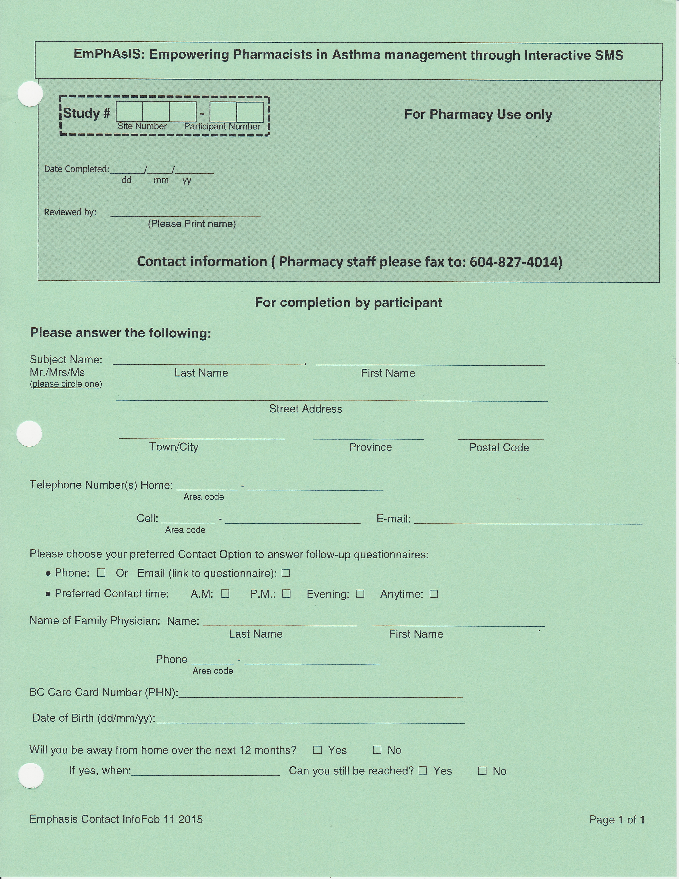
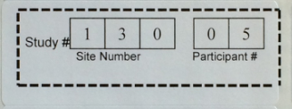
+
2. Complete Enrolment
Contact Information Form
Please stick the Patient Study ID sticker onto the form
Patients can complete the contact form themselves, but verify that ALL FIELDS are completed!
Notes:
On the inside pocket of your binder, you will find sheets of patient ID labels. Each row of labels are for the same participant. Take one label which has the patient study ID and stick it on the contact information form upper left corner makred by a dashed box. Allow the patient to fill out their information and please make sure all questions have been answered.

Slide 7
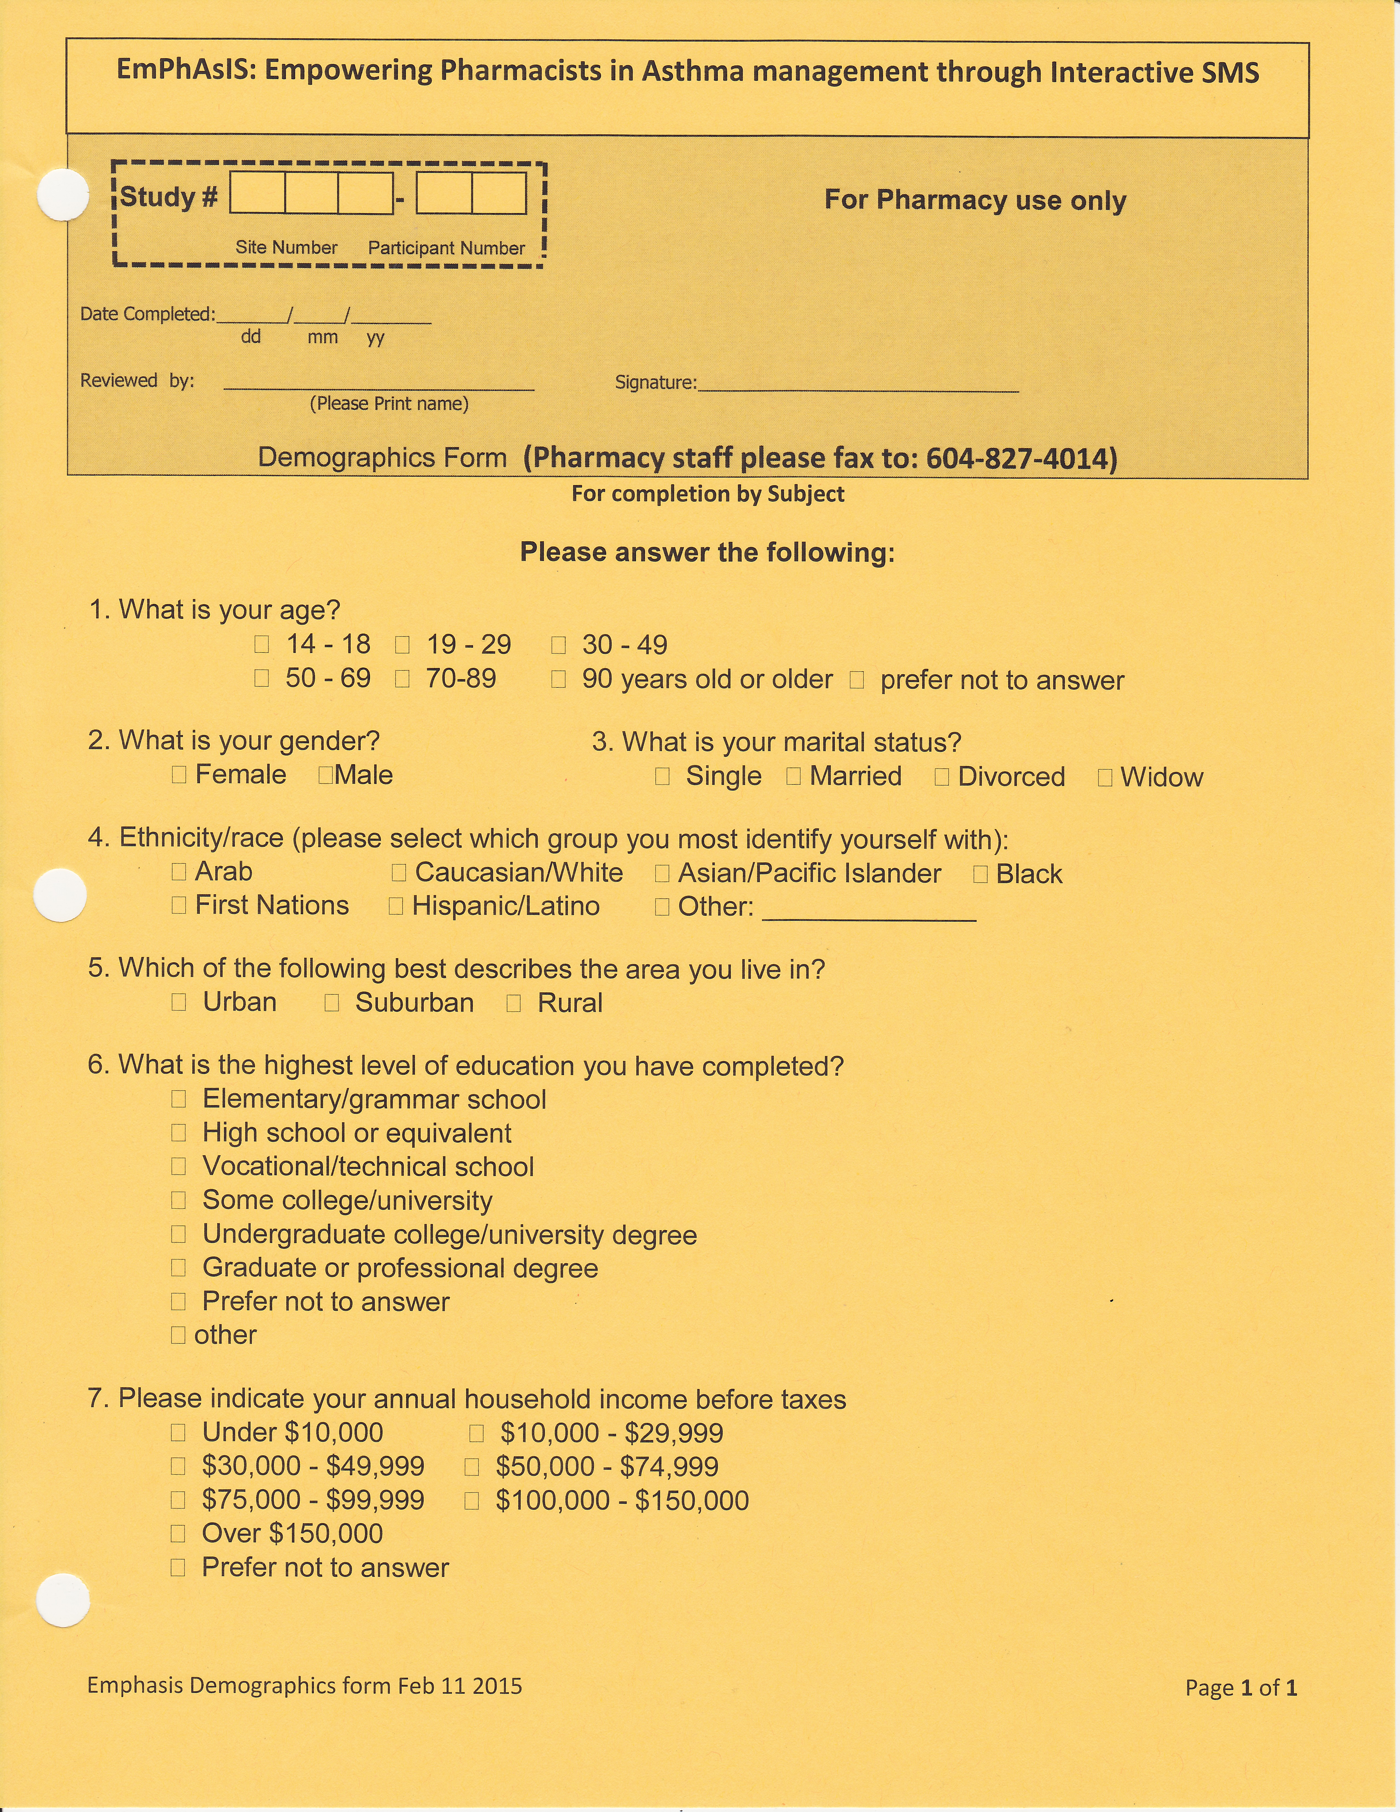
+
2. Complete Enrolment
Demographic Form
Please stick the Patient Study ID sticker onto the form
Patients can complete the contact form themselves, but verify that ALL FIELDS are completed!
Notes:
Place the same label with the patients’ study ID on the yellow demographics form and allow the patient to complete this form as well.

Slide 8
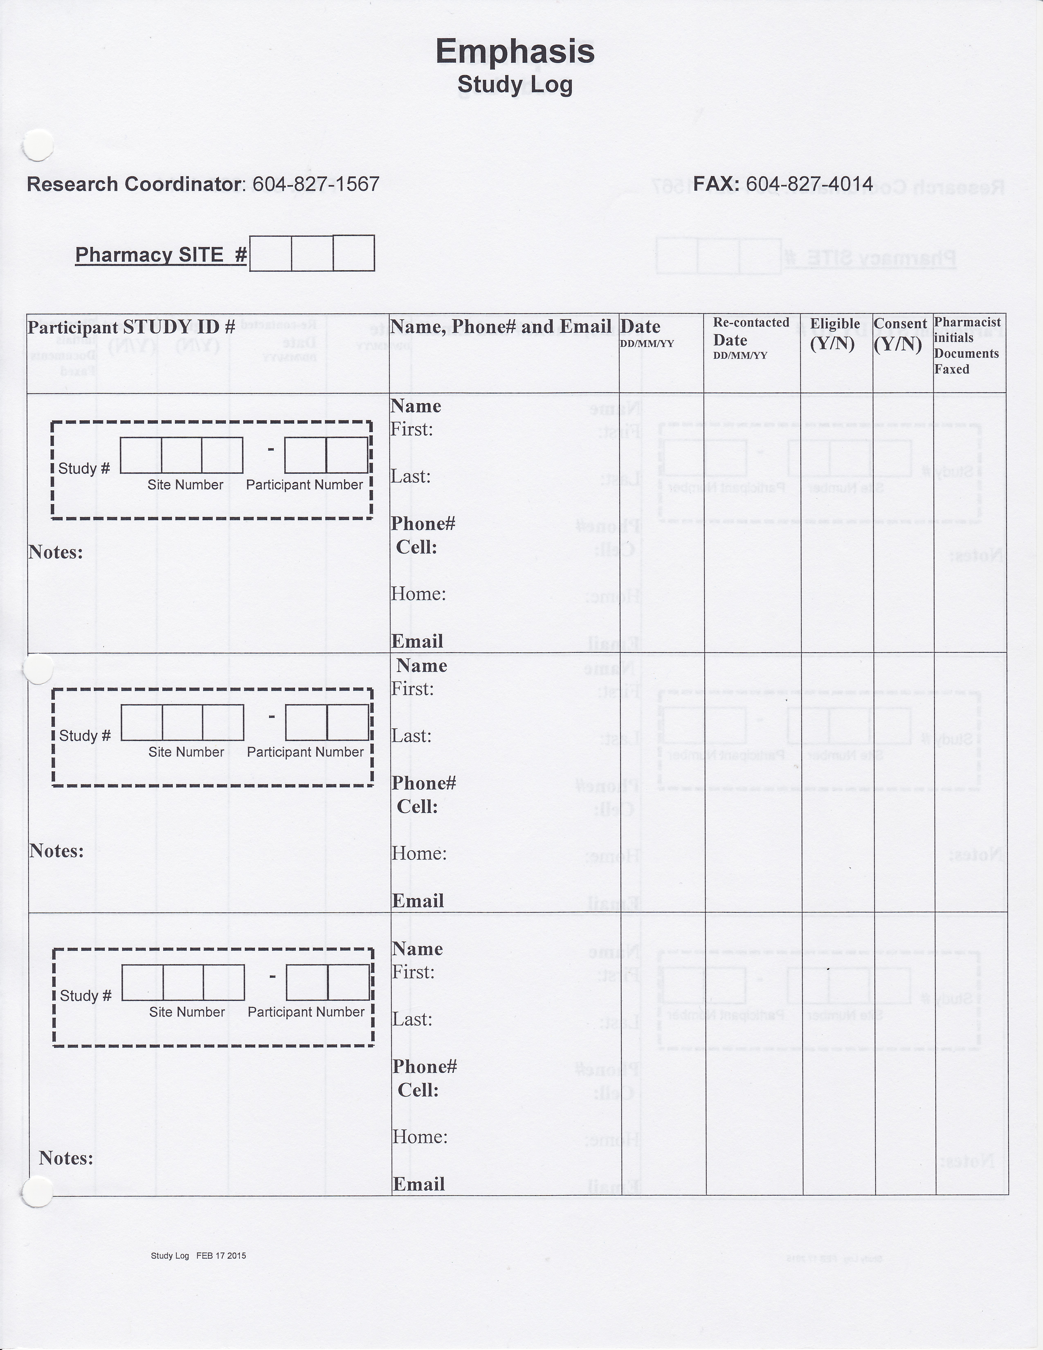
2. Complete Enrolment
+
Once the patient has completed the Contact Form and the Demographic Form…
Fax to UBC 604-827-4014
File in your binder (“Completed Forms” tab)
Update the Study Log
Found at the front of your binder
Notes:
Remember to fax the signed consent form, the contact information form, and the demographics form all to UBC at the fax number noted. File all papers in the back of your binder.
Now the patient can go home with their copy of the subject information and signed consent form, the participant guide and magnet if they are in the intervention group. To update your record keeping, use the study log found at the front of your binder.

Slide 9
2. Complete Enrolment
Fill in your Site #
(i.e. 007)
Please stick the Patient Study ID sticker onto the form
Fill in patient name and relevant contact information
Notes:
Place the remaining patient ID sticker in the dashed box on the study log. Beside it, fill out the patients name and relevant contact information. This helps you keep track of which of your patients are enrolled in the emphasis study.

Slide 10
+
3. Notify Physician
Fax the Physician Letter to physicians in your community
Notes:
As a courtesy, we have included a physician letter in your binder. You may choose to fax this letter to physicians you know in your area, to notify them that their patient might be enrolled in a study on asthma medication adherence at your pharmacy.

Slide 11
Congratulations!
You have now successfully consented and enrolled a patient into the study!
If you are an Usual Care Pharmacy, please see next mini-webinar on:
“Baseline Procedures: Usual Care Pharmacy, Next Steps”
If you are an Intervention Pharmacy, please see next mini-webinar on:
“Baseline Procedures: Intervention Pharmacy, Next Steps”
Notes:
Congratulations! You have now successfully consented and enrolled a patient into the study! Read rest of slide.

Slide 12
EmPhAsIS Empowering Pharmacists in Asthma management through Interactive SMS
Questions?
Please do not hesitate to contact us
Dr. Mary De Vera at 604-827-2138 (mdevera@mail.ubc.ca)
Research Coordinator (Louise) at 604-827-1567 (louisega@mail.ubc.ca)
Fax: 604-827-4014
Mailing Address
2405 Wesbrook Mall, Vancouver BC, Canada V6T 1Z3

